Slide 1
CLUSTER: MACHINE LEARNING PROJECT

Slide 2

STOCK BABA: stock price analysis

Slide 3
TEAM GUIDE:
Mr. Syed Mujib Rahaman
GROUP MEMBERS:
PURVIKA
ANUSHA
TANU
SAMBHAVI

Slide 4

In the finance world stock trading is one of the most important activities. Stock market prediction is an act of trying to determine the future value of a stock or other financial instrument traded on a financial exchange. This project explains the prediction of a stock using Machine Learning. The technical and fundamental or the time series analysis is used by most of the stockbrokers while making the stock predictions.
The programming language used to predict the stock market using machine learning is Python. In this project we propose a Machine Learning (ML) approach that will be trained from the available stocks data and gain intelligence and then uses the acquired knowledge for an accurate prediction. In this context this study uses a machine learning technique called LSTM to predict stock prices.

Slide 5


Modeling and Forecasting of the financial market have been an attractive topic to scholars and researchers from various academic fields. The financial market is an abstract concept where financial commodities such as stocks, bonds, and precious metals transactions happen between buyers and sellers. In the present scenario of the financial market world, especially in the stock market, forecasting the trend or the price of stocks using machine learning techniques and artificial neural networks are the most attractive issues to be investigated.

Slide 6
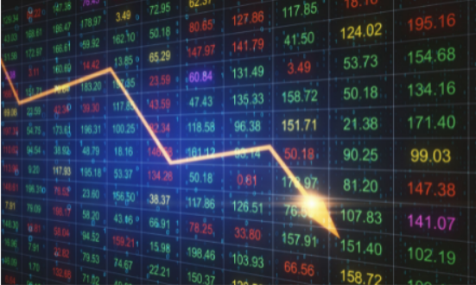
All the changes in prices of the financial market are based on immediate economic events or news. Investors are profit-oriented, their buying or selling decisions are made according to most recent events regardless of past analysis or plans.

Slide 7


Predicting the value of a stock offers great profit potential, which is a major motivation of research in this area. Even a fraction of a second's knowledge of a stock's value can lead to significant profits. The attraction of finding a solution has inspired us to look for the solution to problems including instability, irregularity, and time dependence , where technology can help.

Slide 8
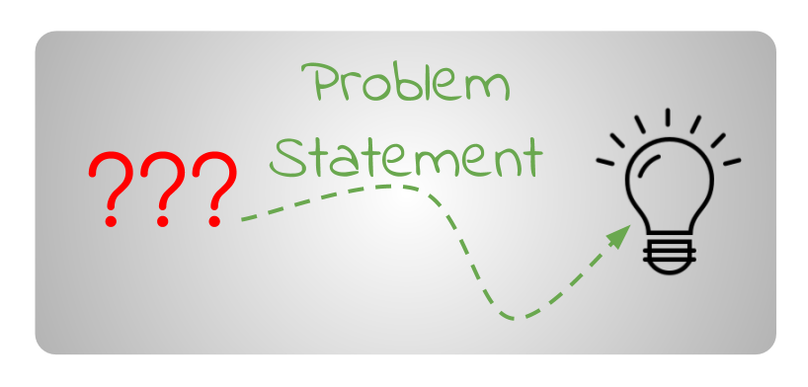

Forecasting the future market is fundamentally unpredictable. Rather than attempting to predict when a reversal will occur, short-term traders are better served by waiting for confirmation that one is approaching. As a result, we can lower the risk factor for investors by implementing machine learning.

Slide 9
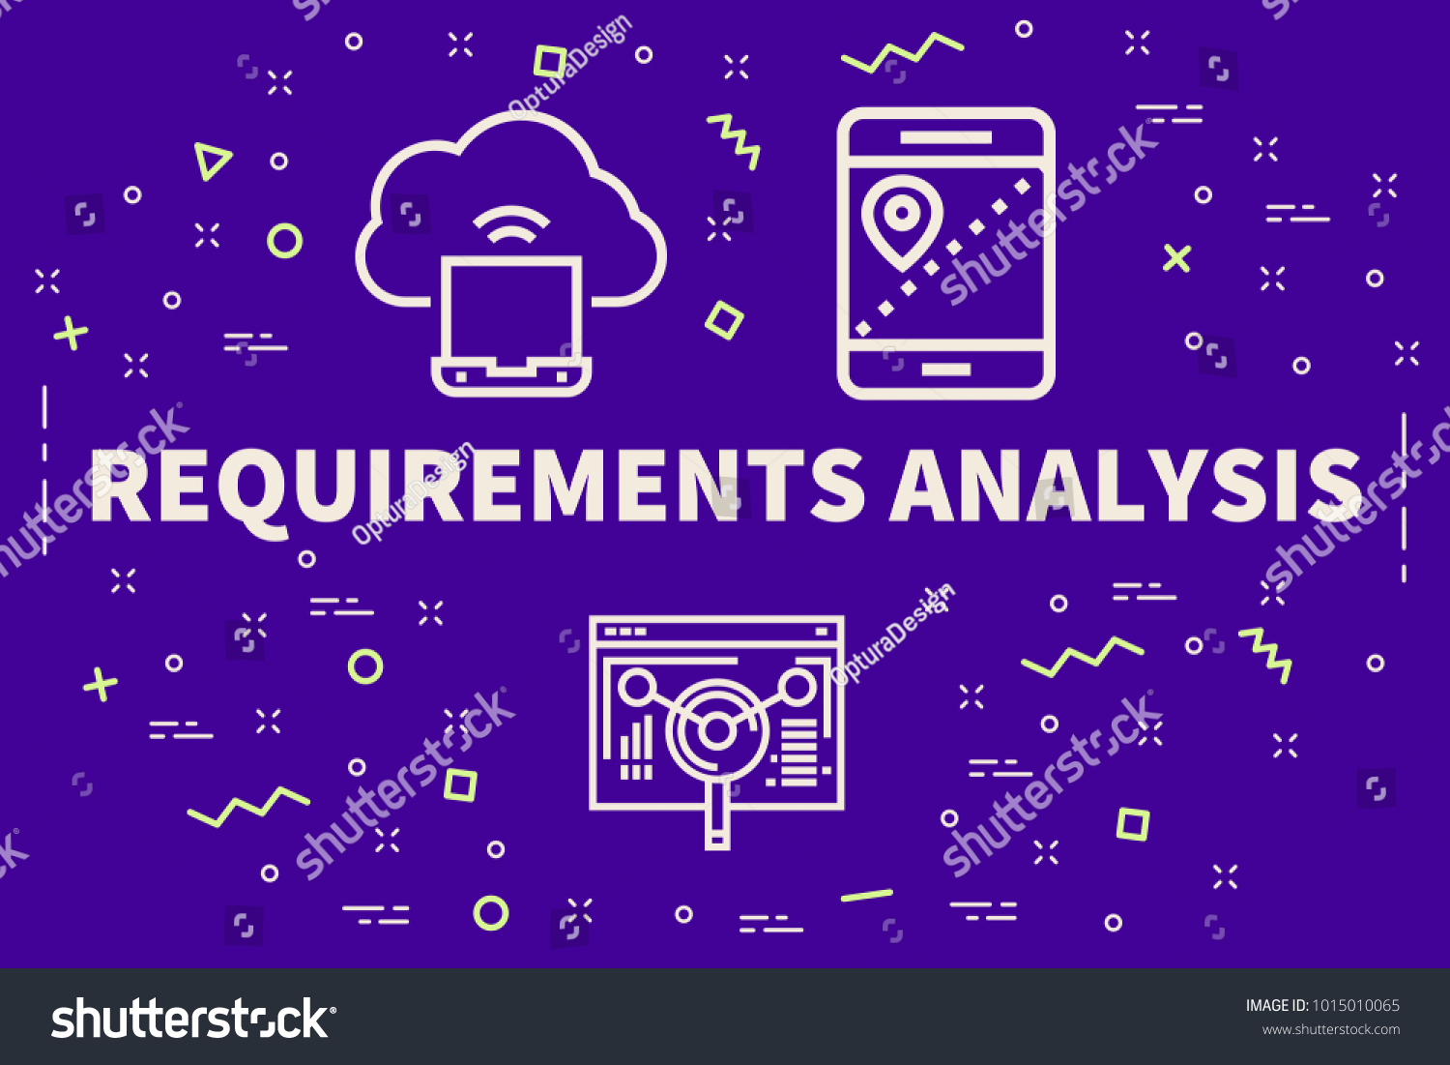
Functional Requirement:
The software shall accept the dataset as input.
The software shall do pre-processing (like verifying for missing data values) on input for model training.
The software shall use LSTM ARCHITECTURE as the main component of the software.
The system should be able to generate an approximate share price

Slide 10
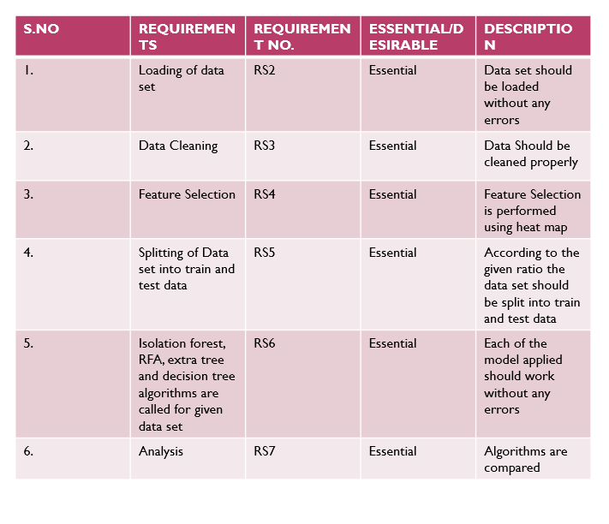
SYSTEM REQUIREMENT SPECIFICATION

Slide 11
Non Functional Requirements
Usability:
It defines the user interface of the software in terms of simplicity of understanding the user interface of stock prediction software, for any kind of stock trader and other stakeholders in the stock market.
Efficiency:
Maintaining the possible highest accuracy in the closing stock prices in the shortest time with available data.
Reliability:
The reliability of the product will be dependent on the accuracy of the dataset of purchase, how much stock was purchased, high and low value range as well as opening and closing figures. Also the stock data used in the training would determine the reliability of the software.
Security:
The user will only be able to access the website using his login details and will not be able to access the computations happening at the back end.
Maintainability:
The maintenance of the product would require training of the software by recent data so that their commendations are up to date. The database has to be updated with recent values.

Slide 12
Hardware Requirements:
• RAM: 4 GB
• Storage: 500 GB
• CPU: 2 GHz or faster
• Architecture: 32-bit or 64-bit
Software Requirements:
• Python 3.5 in Google Colab is used for data pre-processing, model training and
prediction.
• Operating System: windows 7 and above or Linux based OS or MAC OS

Slide 13
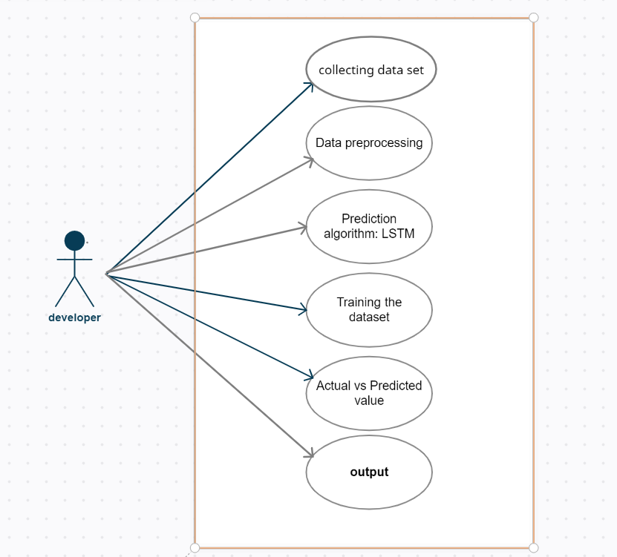
Use case diagram

Slide 14
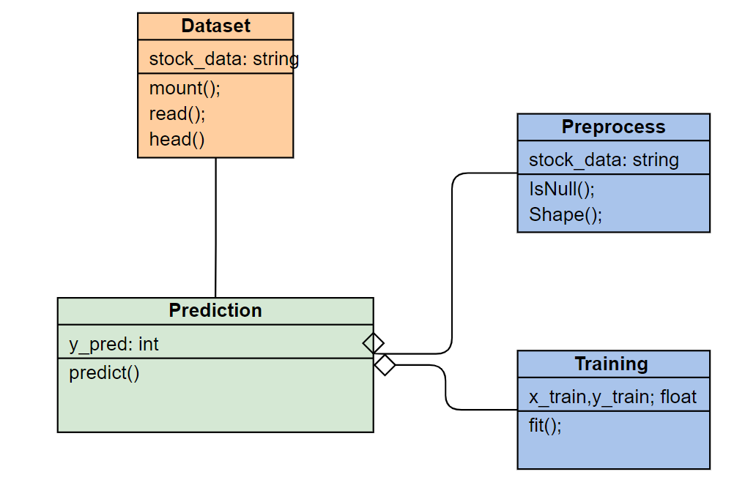
Class diagram

Slide 15
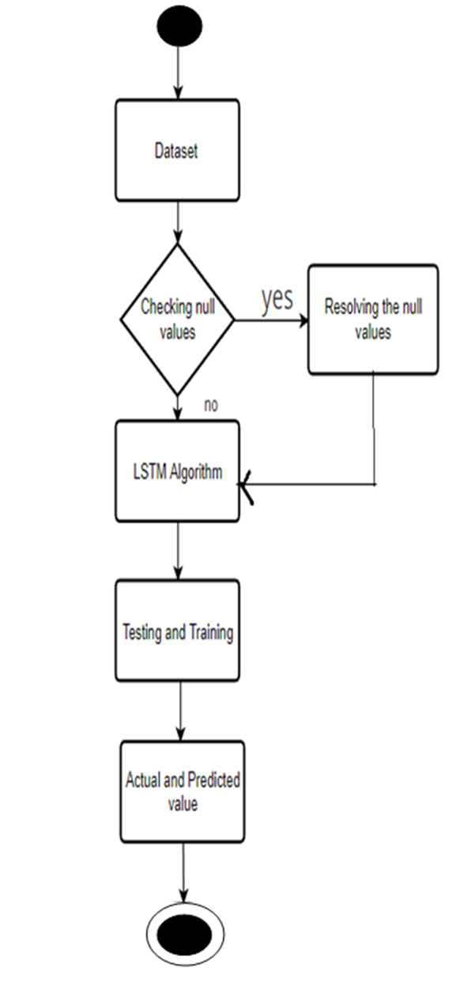
Activity Diagram

Slide 16
Algorithm used:
LSTM is a Recurrent Neural Network that works on data sequences, learning to retain only relevant information from a time window. New information the network learns is added to a “memory” that gets updated with each timestep based on how significant the new sample seems to the model. Over the years, LSTM has revolutionized speech and handwriting recognition, language understanding, forecasting, and several other applications that have become the new normal today.
A standard LSTM cell comprises three gates: the input, output, and forget gate. These gates learn their weights and determine how much of the current data sample should be remembered and how much of the past learned content should be forgotten. This simple structure is an improvement over the previous and similar RNN model.

Slide 17
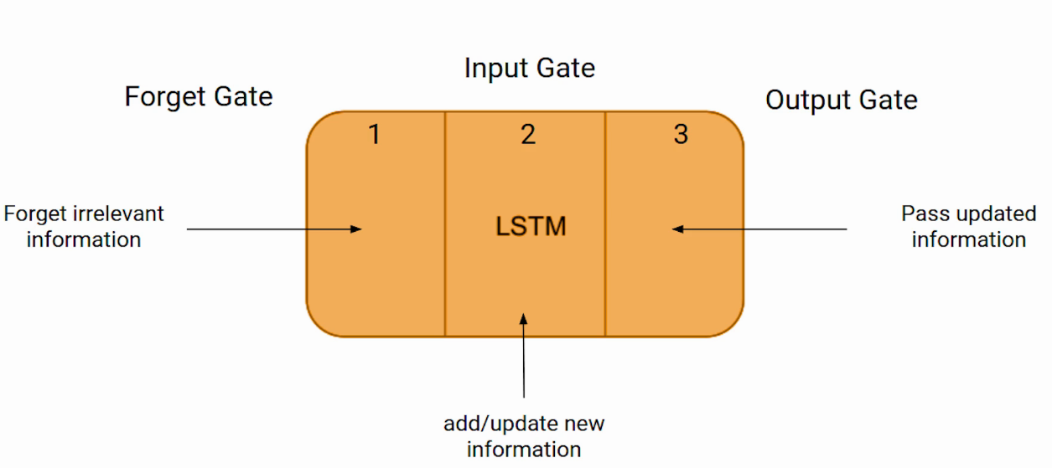

Slide 18
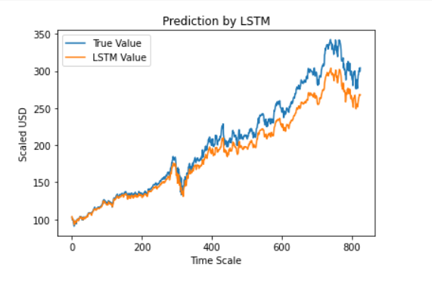
OUTPUT

Slide 19
Test Case
S NO. | REQUIREMENTS | REQ. NO | ESSENTIAL/DESIRABLE | DESCRIPTION | EXPECTED OUTPUT | ACTUAL OUTPUT | RESULT
1. | Loading of data set | RS2 | Essential | Data set is downloaded from Kaggle and then loaded | Data set should be loaded without any errors | Data set should be loaded without any errors | Success
2. | Data Cleaning | RS3 | Essential | Data set is checked for null values ; if any null values are found they should be handled | Data should be cleaned and should contain no null values | No null values are found | Success
3. | Feature selection | RS4 | Essential | Feature selection is done by using heat map | Heatmap shows whether all columns are relevant or not to the target | Heatmap is generated and all the feautres are found to be significant | Success
4. | Splitting of data set into train and test data | RS5 | Essential | Data set is split into train and test data in the ratio 8:2 | According to the given ratio the data set should be split into train and test data | The given data set is split into train and test data in 8:2 ration | Success
5. | Isolation forest, RFA, extra tree and decision tree algorithms are called for given data set | RS6 | Essential | Isolation forest, RFA, extra tree and decision tree are applied | Each of the model applied should work without any errors | Results are classified into fraud and non fraud transaction | Success
6. | Evaluation and comparison of models | RS7 | Essential | The confusion matrix, accuracy, precision, recalll and FI-score are measured | All the evaluation properties are measured properly | All the properties are measured and compared | Success

Slide 20
Conclusion:
However, with the introduction of Machine Learning and its strong algorithms, the most recent market research and Stock Market Prediction advancements have begun to include such approaches in analyzing stock market data. The Opening Value of the stock, the Highest and Lowest values of that stock on the same days, as well as the Closing Value at the end of the day, are all indicated for each date. Furthermore, the total volume of the stocks in the market is provided. With this information, it is up to the job of a Machine Learning Data Scientist to look at the data and develop different algorithms that may help in finding appropriate stocks values.
Predicting the stock market was a time-consuming and laborious procedure a few years or even a decade ago. However, with the application of machine learning for stock market forecasts, the procedure has become much simpler. Machine learning not only saves time and resources but also outperforms people in terms of performance.

